Slide 1
PROJECT NAME
Configuring a Firewall in Linux

Slide 2
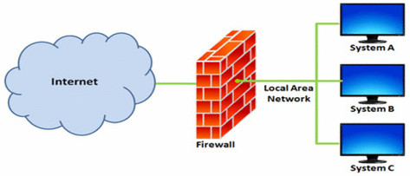

Slide 3
What is Firewall: A firewall is a network security device or software that monitors and controls incoming and outgoing network traffic based on predetermined security rules. It acts as a barrier between a trusted internal network and untrusted external networks, such as the internet, to block unauthorized access and protect against cyber threats.
Types of Firewalls:
Firewalls can be categorized based on their deployment, functionality, and where they operate within the network stack.
Here are the main types of firewalls:
Packet Filtering Firewall.
Stateful Inspection Firewall.
Proxy Firewall (Application Layer Firewall).
Next-Generation Firewall (NGFW).
Hardware Firewall.
Software Firewall.

Slide 4
Firewall Terminology:
Firewall terminology refers to the specialized vocabulary used to describe various aspects of firewall technology, configuration, and operation.
Here are some key terms commonly used in firewall terminology:
Packet Filtering: Examines packets based on criteria like IP addresses, ports, and protocols.
Stateful Inspection: Tracks network connections and only allows legitimate packets.
Access Control Lists (ACLs): Rules that permit or deny traffic based on various criteria.
DMZ (Demilitarized Zone): A buffer zone between internal and external networks.
Intrusion Detection System (IDS): Monitors traffic for suspicious activity.
Intrusion Prevention System (IPS): Actively blocks detected threats.
Proxy: Intermediary server that performs security checks.
Application Layer Gateway (ALG): Enforces security policies at the application layer.
Virtual Private Network (VPN): Secure encrypted connection for remote access.
Firewall Rules: Instructions that dictate how traffic is handled based on specific criteria.

Slide 5
IP address (Internet Protocol address):
An IP address is a numerical label assigned to each device connected to a computer network that uses the Internet Protocol for communication. It serves two main purposes:
Identification: An IP address uniquely identifies a device on a network. It acts like a postal address, allowing data to be sent to and received from specific devices.
Location addressing: IP addresses are used for routing data packets across networks. They help routers and other network devices determine where to send data within a network or across the internet.
Types of IP Addresses:
There are two primary versions of IP addresses:
1. IPv4 (Internet Protocol version 4): The original IP address format, which uses 32-bit addresses.
2. IPv6 (Internet Protocol version 6): A newer format that uses 128-bit addresses, written in a hexadecimal format.

Slide 6
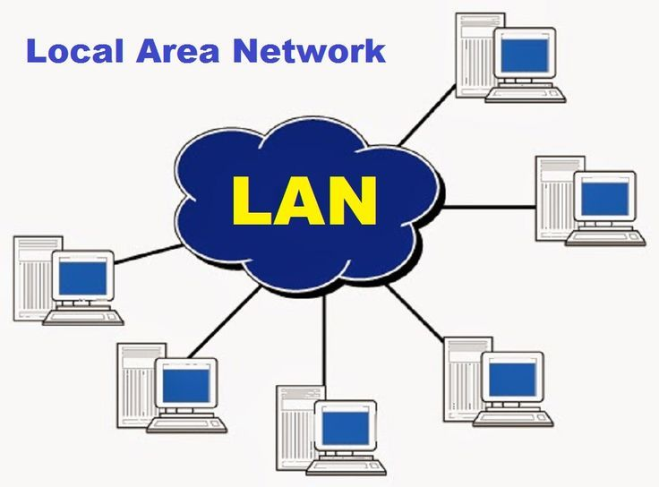

Slide 7
LAN (Local Area Network):
LAN stands for Local Area Network.
It refers to a network of interconnected devices within a limited area such as a home, office building, school, or campus.
LANs are typically confined to a single geographic location and are used for sharing resources, such as files, printers, and internet connections, among connected devices.
Characteristics of LAN:
Localized: Covers a small area, such as a home, office building, or campus.
High-speed: Typically uses high-speed networking technologies like Ethernet or Wi-Fi.
Private: Not publicly accessible; access is restricted to authorized devices and users.
Peer-to-peer: Devices can communicate directly with each other without relying on a central server.
Applications of LAN:
File Sharing: Users can share files and resources (e.g., printers, scanners) within the network.
Internet Access: LANs provide shared access to the internet through a router or gateway device.
Communication: Facilitates communication between devices and users via email, instant messaging, and video conferencing.
Resource Sharing: Allows multiple users to access shared software applications and databases hosted on servers within the LAN.

Slide 8
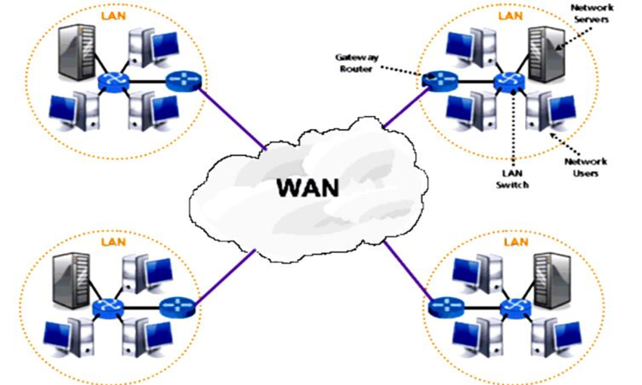

Slide 9
WAN (Wide Area Network):
WAN stands for Wide Area Network.
A Wide Area Network (WAN) is a telecommunications network that spans a large geographical area, connecting multiple LANs (Local Area Networks), individual computers, or other networks together.
WANs are designed to facilitate communication and data exchange between geographically dispersed locations, often across cities, countries, or continents.
Characteristics of WAN:
Large scale: Covers a large geographical area, often connecting multiple sites or regions.
Long-distance: Spans distances ranging from tens to thousands of kilometers.
Public or private: Can be public (e.g., the internet) or private (e.g., a company's dedicated network).
High-speed: Typically uses high-speed networking technologies like fiber optics, satellite links, or high-speed wireless connections.

Slide 10
Applications of WAN:
Internet Connectivity: Provides access to the global internet and allows users to communicate and access online resources.
Enterprise Connectivity: Facilitates communication and data exchange between multiple offices, branches, or remote locations of an organization.
Cloud Connectivity: Enables access to cloud-based services and resources hosted in data centers located across different regions.
Telecommunication Services: Supports services such as voice communication (VoIP), video conferencing, and unified communications over long distances.
Data Replication and Backup: Facilitates data replication and backup across distributed locations for disaster recovery and business continuity purposes.

Slide 11
Internet Traffic:
Internet traffic refers to the flow of data across the internet, encompassing various types of communication and services.
Here are the main types of internet traffic, along with their protocols and examples:
Web Traffic (HTTP/HTTPS):
HTTP (Hyper Text Transfer Protocol): The protocol used for transmitting web pages and other web resources over the internet.
HTTPS (Hyper Text Transfer Protocol Secure): An extension of HTTP that uses encryption (SSL/TLS) to secure data transmission between the web server and the client.
Examples: Browsing websites, accessing web applications, streaming videos.
Email Traffic (SMTP/IMAP/POP3):
SMTP (Simple Mail Transfer Protocol): Used for sending emails from a client to a server or between servers.
IMAP (Internet Message Access Protocol): Used by email clients to retrieve messages from a mail server.
POP3 (Post Office Protocol 3): Another protocol for retrieving emails, which downloads messages to the client and often deletes them from the server.
Examples: Sending and receiving emails.

Slide 12
File Transfer Traffic (FTP/SFTP):
FTP (File Transfer Protocol): Used for transferring files between a client and a server over a network.
SFTP (SSH File Transfer Protocol): A secure version of FTP that uses SSH (Secure Shell) for encryption.
Examples: Uploading and downloading files, sharing large datasets.
Voice Traffic (VoIP):
VoIP (Voice over Internet Protocol): Enables voice communication and multimedia sessions over the internet.
Examples: Internet phone calls, video conferencing.
Real-Time Communication Traffic:
Protocols: WebRTC (Web Real-Time Communication), SIP (Session Initiation Protocol).
Examples: Live chats, video calls, online gaming.

Slide 13
DNS Traffic (Domain Name System):
DNS (Domain Name System): Translates domain names to IP addresses, enabling browsers to locate and access websites.
Examples: Resolving domain names, network service lookups.
Cloud Services Traffic:
Protocols: Varies depending on the service (e.g., AWS, Google Cloud, Microsoft Azure).
Examples: Accessing cloud storage, cloud computing resources, SaaS applications.

Slide 14
IP Header:
An IP header is a critical component of internet protocol (IP) packets, which are the fundamental units of data transmission over the internet.
The IP header contains essential information that helps routers and other network devices forward packets efficiently and accurately.
Here are the key fields in an IP header:
1. Version (4 bits): Indicates the IP protocol version. For IPv4, this value is 4.
2. Header Length (IHL) (4 bits): Specifies the length of the IP header in 32-bit words. The minimum value is 5, which corresponds to 20 bytes.
3. Type of Service (TOS) / Differentiated Services (DS) (8 bits): Indicates the quality of service desired, such as delay, throughput, reliability, and priority.

Slide 15
4. Total Length (16 bits): Specifies the entire packet size, including header and data, in bytes. The minimum size is 20 bytes, and the maximum is 65,535 bytes.
5. Identification (16 bits): Used to uniquely identify fragments of an original IP packet. It helps in reassembling the fragments into the original packet.
6. Flags (3 bits): Contains control flags used for fragmentation.
DF (Don't Fragment): If set, instructs routers not to fragment the packet.
MF (More Fragments): If set, indicates that there are more fragments following this one.
7. Fragment Offset (13 bits): Specifies the position of this fragment in the original packet, measured in 8-byte blocks.

Slide 16
8. Time to Live (TTL) (8 bits): Indicates the maximum time the packet is allowed to remain in the network. Each router that forwards the packet decrements this value by one. When TTL reaches zero, the packet is discarded.
9. Protocol (8 bits): Identifies the protocol used in the data portion of the IP packet. Common values include:
ICMP (Internet Control Message Protocol)
TCP (Transmission Control Protocol)
UDP (User Datagram Protocol)
10. Header Checksum (16 bits): A checksum for error-checking the IP header. If the checksum is incorrect, the packet is discarded.
11. Source IP Address (32 bits): The IP address of the sender.
12. Destination IP Address (32 bits): The IP address of the receiver.

Slide 17
TCP Header:
The TCP (Transmission Control Protocol) header is a crucial component of the TCP segment, which provides reliable, ordered, and error-checked delivery of data between applications running on hosts in an IP network.
Here are the key fields in an TCP header:
1. Source Port (16 bits): Specifies the port number of the sending application.
2. Destination Port (16 bits): Specifies the port number of the receiving application.
3. Sequence Number (32 bits): Used to identify the order of the bytes sent from the sender to the receiver. It helps in reassembling the data correctly at the receiver's end.
4. Acknowledgment Number (32 bits): Contains the sequence number of the next byte that the sender of the segment is expecting to receive. This is used to acknowledge the receipt of data.

Slide 18
5. Data Offset (4 bits): Also known as the header length, it indicates the size of the TCP header in 32-bit words. This field specifies where the data begins.
6. Reserved (3 bits): Reserved for future use and must be set to zero.
7. Flags (9 bits): Control flags that indicate specific control information.
8. Window Size (16 bits): Specifies the size of the sender's receive window (buffer space available). This value is used for flow control.
9. Checksum (16 bits): A checksum used for error-checking the header and data. If the checksum is incorrect, the segment is discarded.
10. Urgent Pointer (16 bits): Points to the sequence number of the byte following urgent data. It is only significant if the URG flag is set.
11. Padding (variable length): Used to ensure the header is a multiple of 32 bits.

Slide 19
What is UFW:
UFW (Uncomplicated Firewall) is a user-friendly interface for managing firewall rules on Linux systems. It simplifies the process of configuring and managing firewall settings, making it accessible even to those with limited experience in network security.
Here are some common UFW commands :-
Sudo ufw status: This command is used to check if the firewall is active or not.
sudo ufw enable: This command is used to enable the firewall.
sudo ufw disable: This command is used to disable the firewall service on your system.
sudo ufw deny from (IP address): This command is used to block all network connections that originate from a specific IP address.
sudo ufw allow from (IP address): This command is used to allow all network connections that originate from a specific IP address.
sudo ufw delete allow from (IP address): This command is used to delete a rule that you previously set up in UFW.
sudo ufw app list: This command is used to list which profiles are currently available.

